Slide 1
NREGA ANALYSIS WITH POWER BI
ADITI BANDE

Slide 2
Overview
2
Introduction
Data Set
Visualization

Slide 3
Introduction to Power BI
Power BI is a business analytics tool by Microsoft that allows users to visualize and share insights from their data through interactive reports and dashboards.
It enables data integration, modeling, and analysis across a variety of sources to support informed decision-making.

Slide 4
Data load
There is simple interface for loading the data set of any type
CSV
EXCEL
JSON

Slide 5
About dataset
NREGA data sets provide information on households registered, work demanded and allocated, employment provided, assets created, payments made to workers, and social audits conducted under the National Rural Employment Guarantee Act in India. They help monitor scheme effectiveness, rural employment impact, and ensure transparency in implementation.

Slide 6
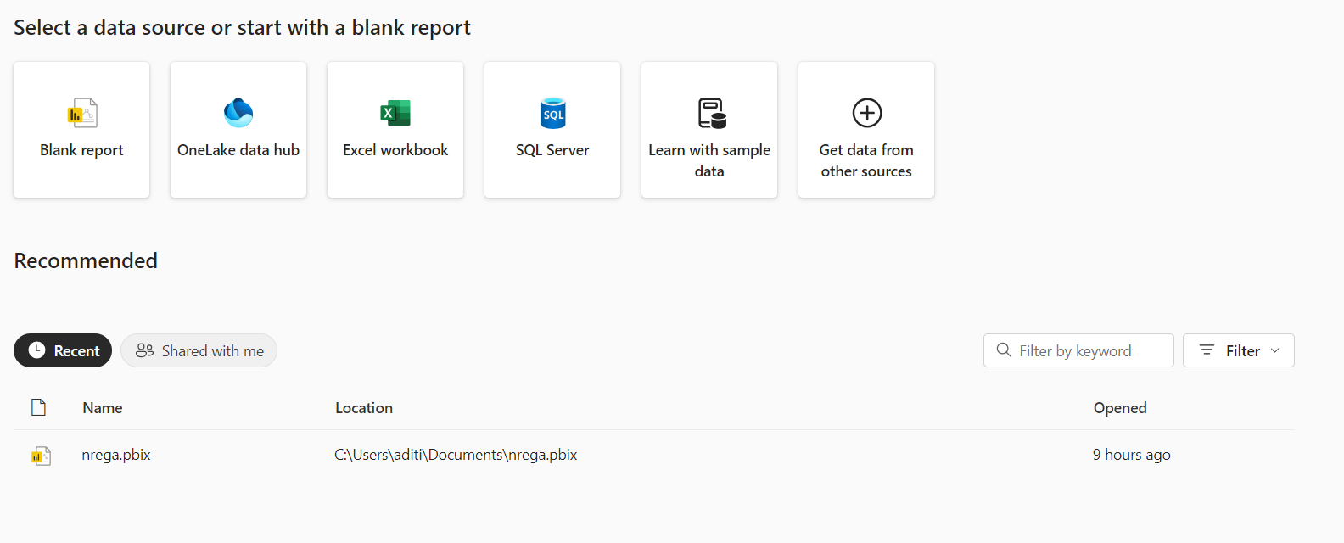
Interface
6

Slide 7
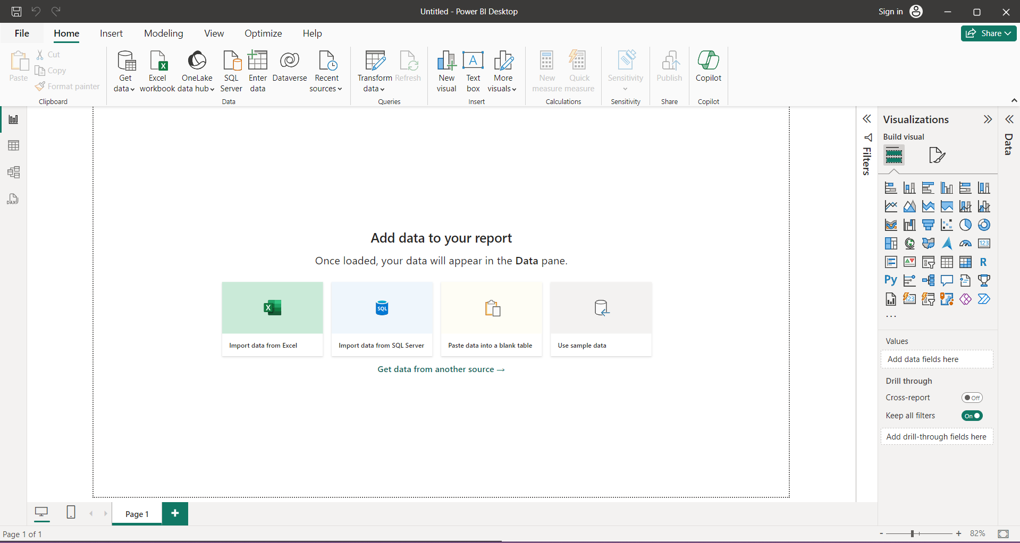

Slide 8
Visualization
Within Power BI, visualization refers to the creation and display of data-driven charts, graphs, maps, and other graphical elements that help users understand trends, patterns, and insights from their data. These visualizations are highly customizable and interactive, allowing users to explore data from different perspectives and uncover actionable insights efficiently.
The other implementation is Provided in the Power BI file
Also the video is attached for the tutorial and the implementation of analysis on the NREGE data set

Slide 9
Thank You

